Slide 1
Project: Next Stages

Slide 2
Pre-trained Vision Transformers (ViT)
Seen their use in Learning to Prompt
More effective than training a ResNet from scratch
Freely and readily available to download (only ~400mb)
Trained on far more data than I could possibly

Slide 3
Classification Layers
Maximising Logits
Pass each sample in, select the argmax logit as the class
Nearest Class Mean
Compute the mean feature embedding for each class using samples in memory
For each sample, compute the Euclidean distance between the mean for each class and current sample’s feature embedding
Closest mean => classify as class

Slide 4
Measuring Uncertainty
Idea inspired by Rainbow
Rainbow augments the sample T times and classifies each sample, counts the no. of augmentations classified as each class, divides this number by T and subtracts from one to get value in [0, 1]
1 is most uncertain, 0 is most certain
Works when you have logits but not with nearest class mean
Propose that for each augmentation, compute its feature embedding, calculate its nearest class according to the class mean, compute the Euclidean distance from the class mean as its uncertainty

Slide 5
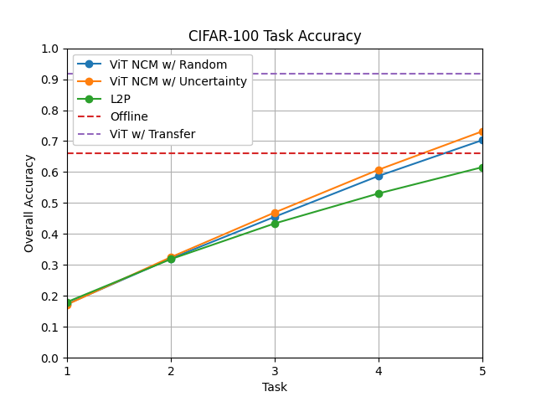
Uncertainty Experiment
L2P is the goal to beat
ViT w/ Transfer comes directly from the original ViT paper where the pretrained model is finetuned on CIFAR-100 via transfer learning (top-1 class instead)
ViT NCM w/ Random selects the last 5000 samples to use for mean calculation
ViT NCM w/ Uncertainty selects diversely uncertain samples like Rainbow
Outperforms random by ~3% absolute accuracy and ~4.3% relative
Much slower to train ~1h20m vs ~10 minutes for random
These require no backpropagation

Slide 6
Combining ViT with Uncertainty and MLP
For each task:
Populate the replay buffer using uncertainty sampling
Use the replay buffer for N epochs:
Augment each sample and compute the ViT features
Use these ViT features to train an MLP
Classify samples using the MLP
(Used CE Loss and 5000 samples in the memory buffer on CIFAR-100)
Very similar to ViT NCM results

Slide 7
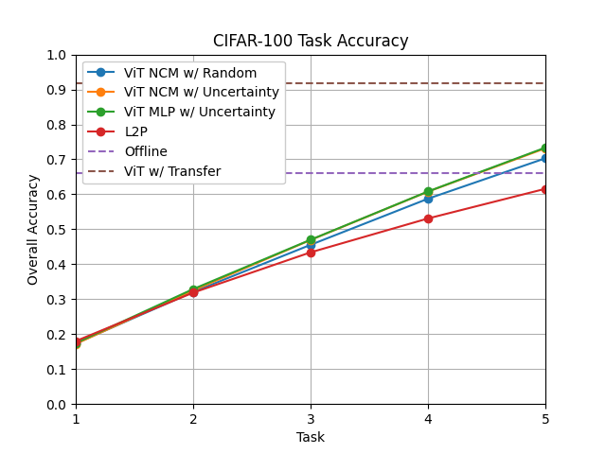
Results

Slide 8
Supervised Contrastive Learning
Seen in Supervised Contrastive Replay (SCR)
Organises the space of features such that samples from each class are close together, others far away
Potential to use this with a ViT to cluster the feature outputs to enhance classification accuracy

Slide 9
Further Experiments
Trialling SCL loss in place of CE loss
Replacing logit maximisation with NCM classification
Ablations: uncertainty sampling vs random sampling
Potentially look at most certain and least certain sampling too

